Slide 1
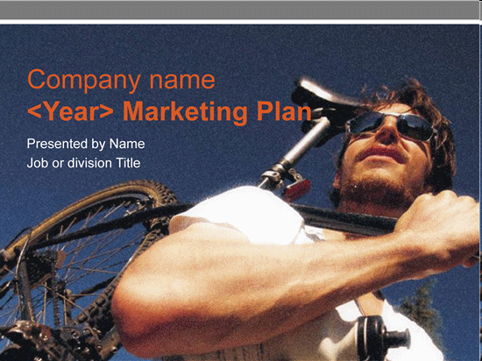
Marketing

Slide 2
VOCABULARY
Fragmented market /‘frægmæntid ma:kit/ - is one where there are lots of small to mid size companies and where even the big players have stiff competition. There should be no dominant company;
Planning marketing campaign /plæn.ɪŋ ‘mɑː.kɪ.tɪŋ kæm’peɪn/ - starts with understanding your position in the market place and ends with details such as the wording or advertising

Slide 3
VOCABULARY
Buying habits /‘bai·n`hæbits/ - purchase of the same brand over and over again ( kupovne navike)
Exceed /ik‘si:d/ - to be greater than, or superior; ( veći, bolji)
Brand initiative /brænd i·niζiætiv/ - offers a revolutionary approach to corporate branding that looks beyond the marketing value of brands company to customer; ( novi pristup u marketinškom oglašavanju zaštitnog proizvoda tvrtke)
Test market /test ma:kit/ - is a geographic region or demographic group used to gauge the viability of a product or service in the mass prior to widescale roll out; (probno tržište)
Marketing strategy /ma:ketiŋ stræt.ə.ʒi/ - is a process that can allow an organization to concentrate its limited resources on the greatest opportunities; ( marketinška strategija)

Slide 4
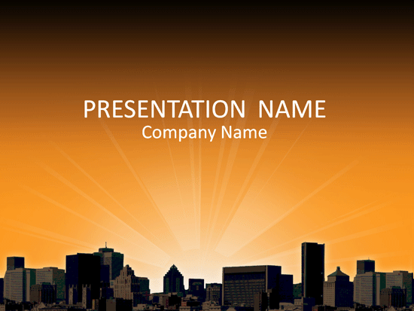
Unit 13

Slide 5
Hello to the good buys
The marketing people from Shell Oil Products were seeking ways to exceed business, the idea was a hassle free and faster fuel buying for customers. They would have to come up with a new strategy by diferentiating the Shell Oil brands on the fragmented market and the mission was to profitably expand the business. Dave Yars, menager of Startegy and Planning- marketing concluded it was important to discover the consumers needs and attitudes. They began with a customer segment study of 55000 people which were stopped in shopping malls in six cities for a 45 minutes interview into their attitude, especially regarding driving cars. The result was that everyone wanted three things from a service station: Competitive price, nearby location, and good quality fuel. They all believed was already delivered. The company wanted better understanding of audiences. A focus group was set up for each segment, they had to find out more about their buying habits. The other team was made of clinical psychologist hired to create a psychological profile of each segment.
The study indicated that three groups should be targeted.

Slide 6
Hello to the good buys
Premium Speeders - outgoing, ambitious, competitive and orientated. They drive upmarket cars. Efficency rules plus fast pumps, quick access and payment
Simplicity Seekers - loyal, caring and sensitive, frustrated with the complexities of everyday life. They want simple and easy transactions.
Safety Firsters - control orientated, confident people, like order and comfort of the familiar. Prefer stay close to their cars.

Slide 7
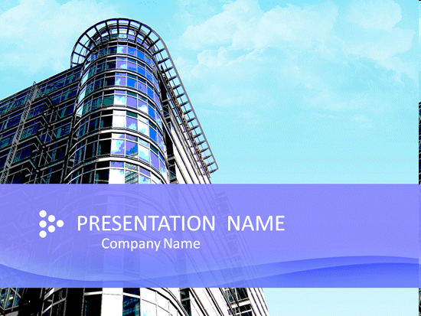
Marketing strategy
Running a succesful business is not like a field of dreams. You can built it but they might not come. Marketing is all about letting people know about your product or service and persuade the audience to buy or use it. Marketing strategy includes the definition about your business, a description about your product or service, a profile of your target users or clients, and defines your companys role in relationship to the competition.

Slide 8

Marketing plan
Marketing plan includes details about your business unique selling proposition, pricing strategy, the sales and distribution plan and your plans for advertising and promotions. You cannot have a marketing plan without a marketing strategy.

Slide 9

Target market
To build a better business is important to identify and serve particular customer group- your target market. First you have to define your product or service because you cannot be all things to all people. Next thing to do is to understand that people purchase is to:
satisfy basic needs
To solve the problems
To make themselves feel good

Slide 10
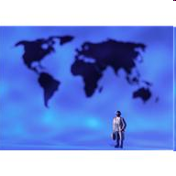
Next step in creating marketing strategy is to zero in on the target market. It means the company has to research the demographics of the community and divide it into market segments; by age, education, income, marital status, ethnic, religious background, family cycle, lifestyle, social class, opinion, attitudes and beliefs. After that the company should have a clear picture of the ideal customer or who they want it to be.

Slide 11
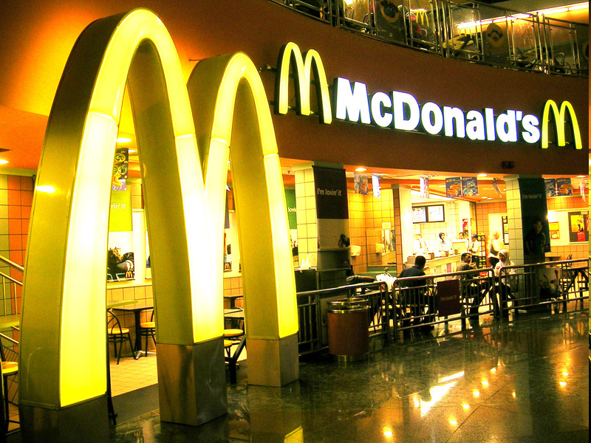
Marketing campaign
An effective marketing campaign will shape your customers image of your company in a positive manner.
You must first define the image you want to portray. MacDonald`s campaign is one of the most successful. Every promotional piece they produce should have the same colour. Wherever you go in the world you will find the same look. Red and yellow is their chosen colour scheme. They have chosen to market their company as a fun place to eat. In designing your marketing campaign be sure to find a way to speak to your customers.

Slide 12

Complete the passage using words from vocabulary
Marketing campaign is a specific series of___used in marketing, a new or changed___ or ___, or in using new marketing___ and __ . Succesful companies tend to be carefully ___, well thought- out and focused on ___ and __.
reasearched, product or service, details and execution, activities, channels and methods

Slide 13
Match the phrases from the box A with the phrases from the box B
A
1. companies seek ways
2. service stations are different
3. Company developes knowledge
4. customer segment study discovered
5. the common thread was
6. new inovations
7. Advertising campaign
B
a) of consumer needs and attitudes
b) they all wanted faster and easier service
c) was launched
d) with a new brand initiative
e) there were different segments with different needs
f) to increase the business
g) are being test marketed

